Slide 1
Using The General Assembly “Dashboard”
Filing Witness Slips Electronically

Slide 2
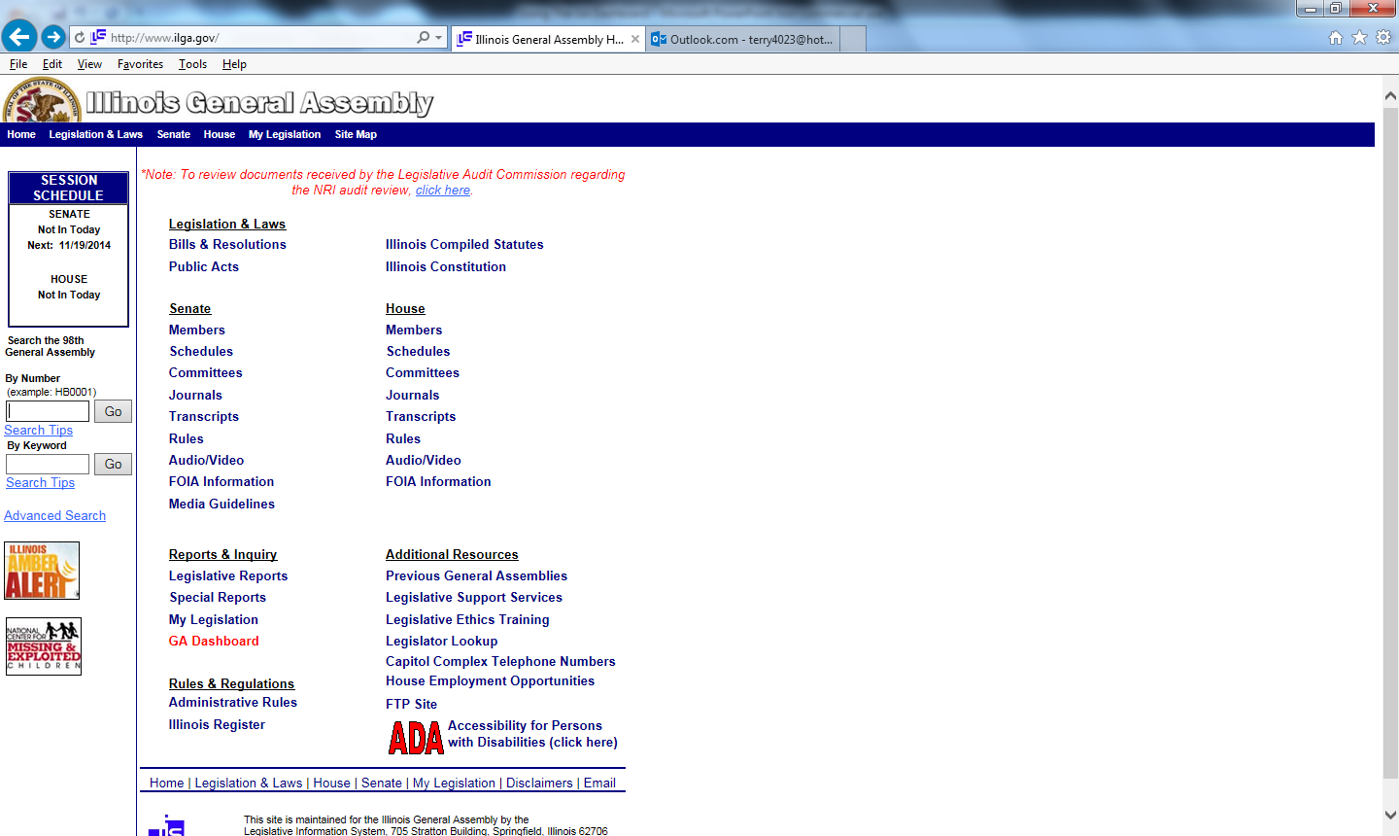
From www.ilga.gov click on “GA Dashboard” link

Slide 3
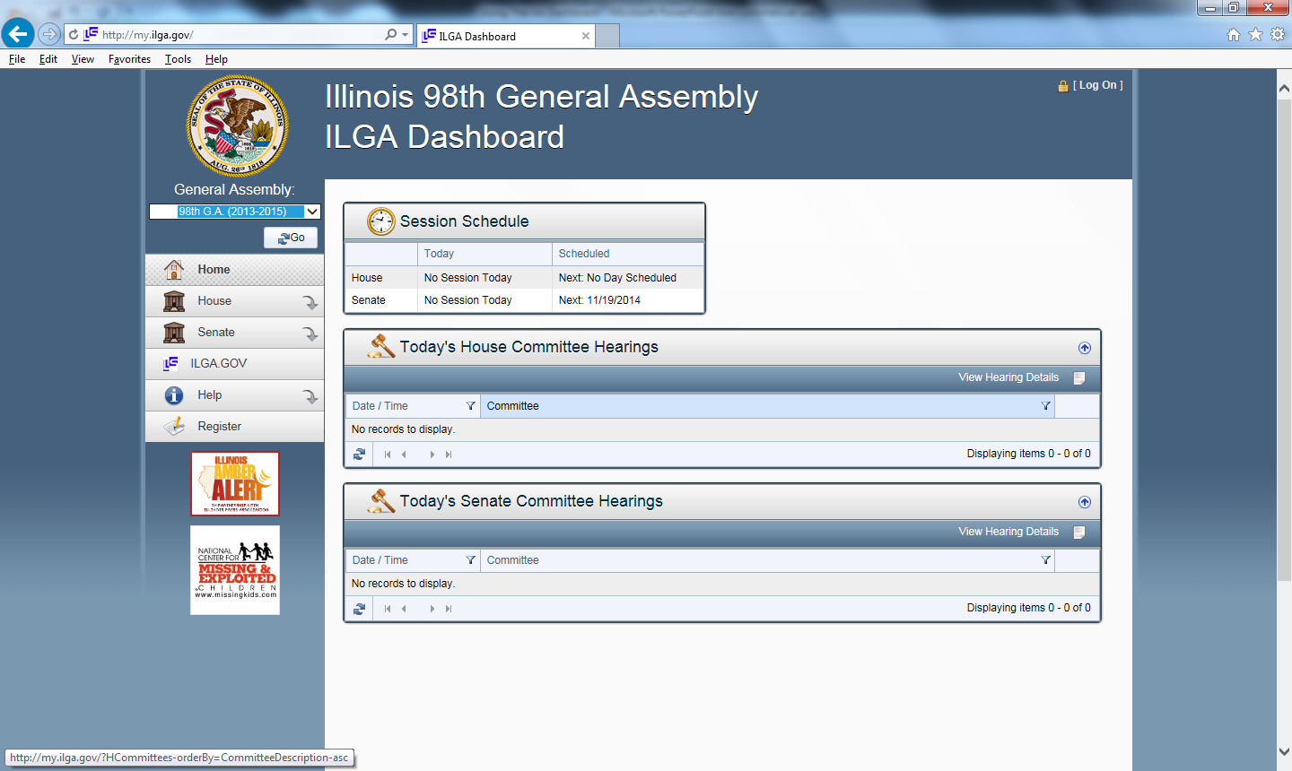
Main page provides a listing of committee hearings scheduled for that day – click on House or Senate link to get other scheduled hearings

Slide 4
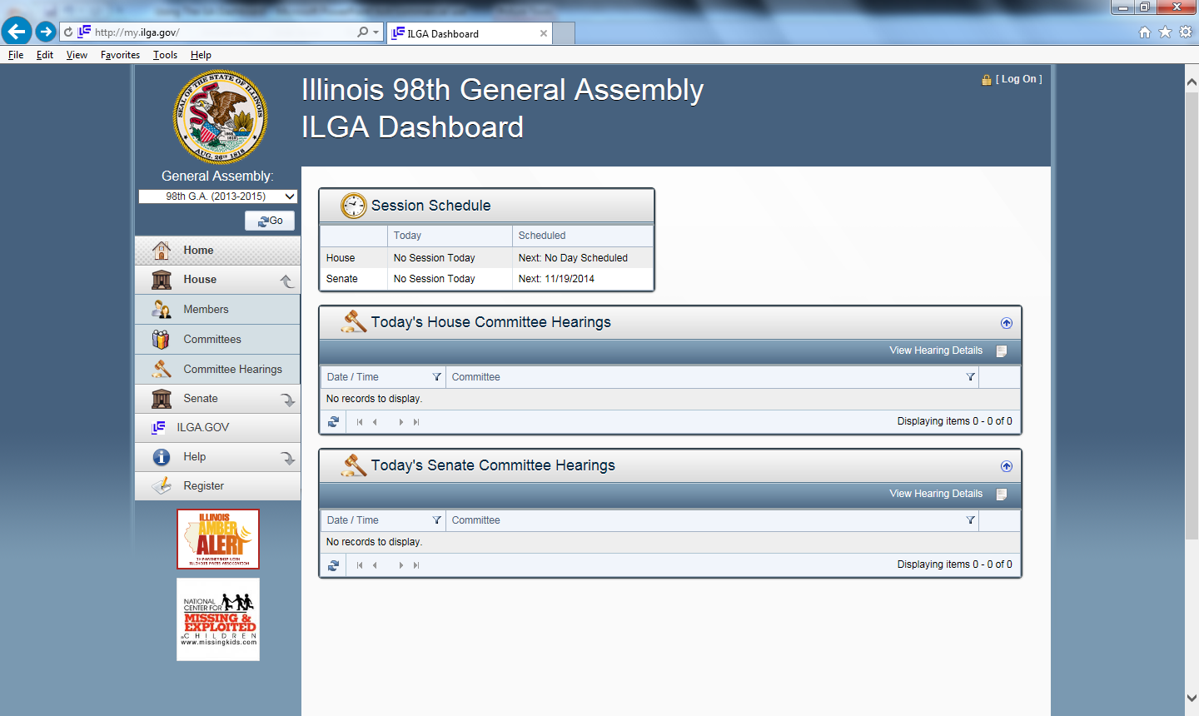
Click on “committee hearings” to access list

Slide 5
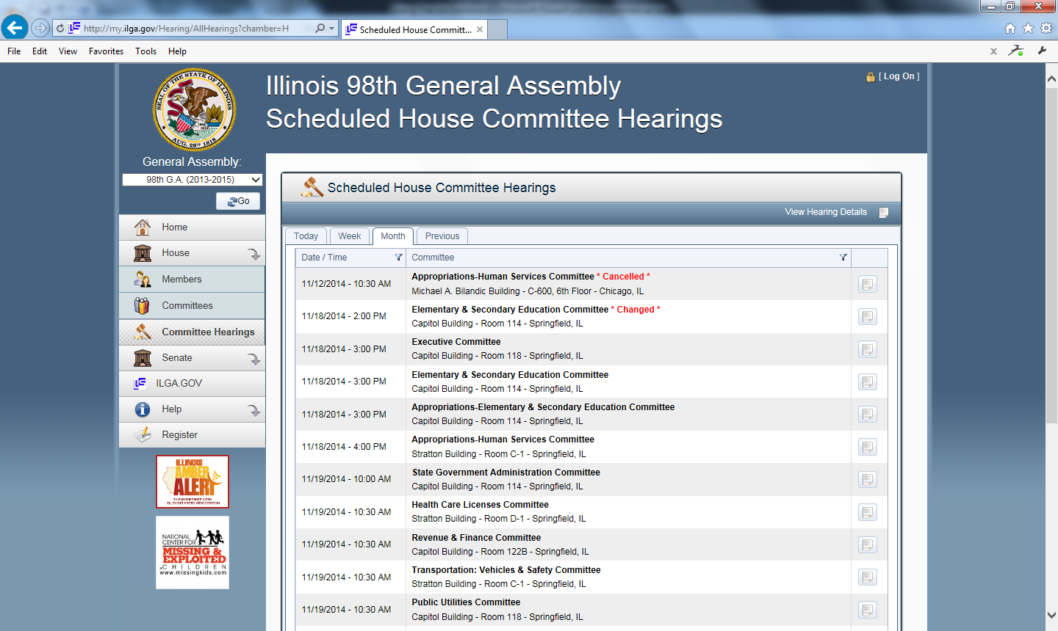
Screen shows hearings scheduled for that day, week, month or previously held meetings

Slide 6
Example of scheduled House hearings – click on right icon to get hearing details

Slide 7
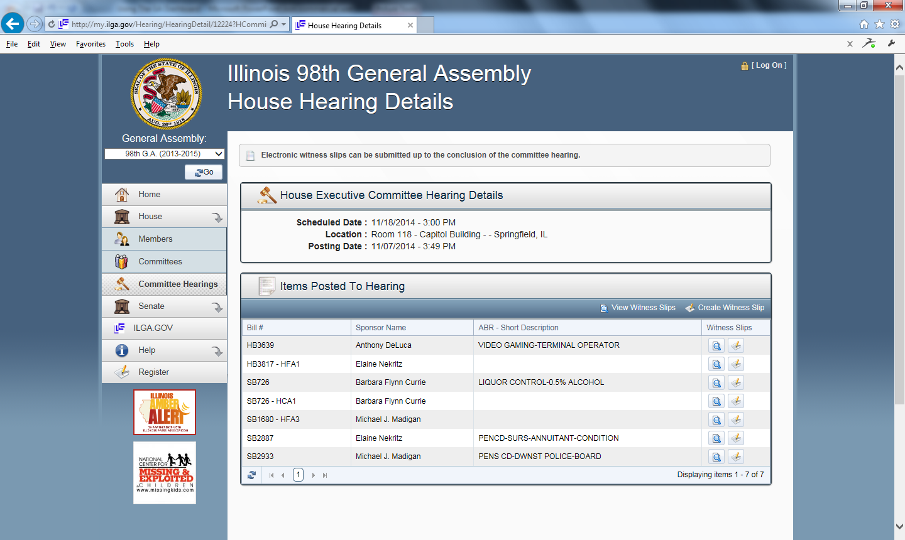
Example of committee action schedule

Slide 8
To create witness slip – Look for correct bill number and then click on “create witness slip” link on the far right

Slide 9
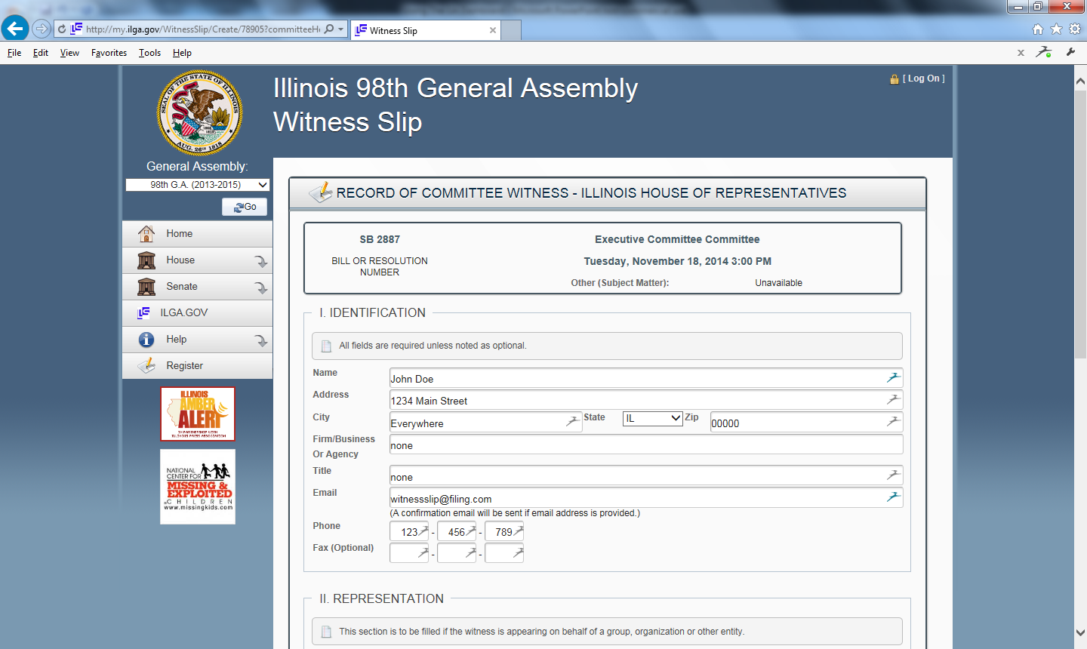
Fill In Name, Address and City

Slide 10
“Firm” and “Title” sections must be completed. Use “none” if appropriate

Slide 11
Fill in e-mail address and phone number. After filing you will receive an e-mail confirmation.

Slide 12
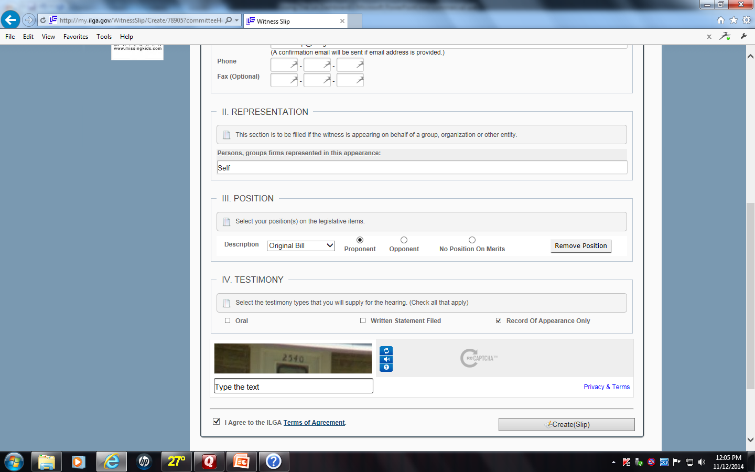
Under “Representation” you can add the name of your organization or “self”

Slide 13
Click on the radio button that signifies your position on the bill … Proponent, Opponent, or No Position. (The drop down box will allow you to file your position on any amendments as well, if necessary.)

Slide 14
Unless you plan to testify in person or provide a written statement, click on the “Record of Appearance Only” radio button.

Slide 15
Type the correct “captcha” number code in the box.

Slide 16
Click the “agree to terms” box and click “submit” and the slip will be filed.

